Slide 1
Invariant Synthesis
Using Counterexample Generalization

Slide 2
Two approaches
In order to strengthen the set of invariants (and make it inductive), we can do the following:
Stay in a general abstract domain and directly compute the weakest precondition (wpr) of the set of invariants.
Find a finite counterexample using the finite model property and the decidability of EPR. Then, generate an invariant of a specific form by generalizing the counterexample. Doing this will generate formulas that are more focused, simple and intuitive than by using wpr.

Slide 3
Counterexample generalization
General abstract domain (no fixed model, no concrete value, no environment)
Concrete domain (types, variables, functions and relations are fully specified with concrete values)
General abstract domain (no fixed model, no concrete value, no environment)
Finding a counterexample
Generalizing the counterexample
We will compare 3 ways of generalizing a counterexample:
Naïve generalization
Generalization with minimization of the constraints (using minSAT and model checking)
Generalization using code analysis

Slide 4
Comparison of different methods
 | Weakest precondition | Naïve CG | CG with minSAT | CG with code analysis
Form of the formulas | ∀∃ (wp is stable for ∀∃ formulas) | ∀ | ∀ | ∀ when possible ∀∃ otherwise
Simplicity of the formula | Long and not intuitive ☹ | Long and often too specific | Short and quite intuitive, sometimes too specific | Short and quite intuitive, sometimes too specific
Level of automation | Fully automated. | Fully automated. | User need to specify a maximum number of steps (transitions) for the model checking. | Can be fully automated. (currently, need help for ∀∃ formulas)
Correctness | Always propose a valid invariant (under some constraints on the code) ☺ | Propose a wrong invariant when no universal invariant exists ☹ | Fail when no universal invariant exists. The generated invariant is checked with model checking. | Can fail in some cases when no universal invariant exists (not characterized yet).

Slide 5
Limits of automated invariant synthesis
In order to find an inductive invariant, we must continue strenghtening the initial set of invariants until a fixpoint is reached (=until the strenghtened set is implied by the previous set).
This fixpoint may never be reached in a finite number of steps. As a result, none of the methods we have seen guarantee to find an inductive invariant automatically.
Synthetizing an inductive invariant is undecidable, so we can’t expect a fully automated method that always terminates.

Slide 6
Naïve generalization
First, we write all constraints that characterize the model and the environment of the counterexample.
Type t1
Type t2
1
= var1
0
~rel1
0:t1 ~= 1:t1
var1 = 1:t1 var2 = 0:t1 ~rel1(0:t2) fun1(0:t2)=1:t1
fun1
0
= var2

Slide 7
Naïve generalization
Then, we replace each concrete value of these constraints by a variable, and we build a formula existentially quantified with these constraints. We can eliminate some variables with simplifications.
0:t1 ~= 1:t1
var1 = 1:t1 var2 = 0:t1 ~rel1(0:t2) fun1(0:t2)=1:t1
A ~= B
var1 = B var2 = A ~rel1(C) fun1(C)=B
var2 ~= var1
~rel1(C) fun1(C)=var1
∃C:t2. var2~=var1 & ~rel1(C) & fun1(C)=var1
Adding vars
A->var2
B->var1
Formula

Slide 8
Naïve generalization
This formula is true for any model/environment that contains a substructure similar to the structure of the counterexample, modulo renaming of concrete values.
We just have to negate this formula in order to have a new invariant that will be added to the previous set of invariants.
∃C:t2. var2~=var1 & ~rel1(C) & fun1(C)=var1
∀C:t2. ~( var2~=var1 & ~rel1(C) & fun1(C)=var1 )

Slide 9
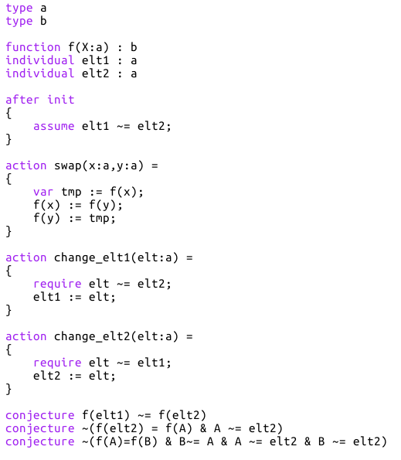
Example 1
We have a function f : a -> b
We have elt1 and elt2, two variables in a such that elt1 ~= elt2
We can change the value of these two variables, but they must always be different
We can also swap two values of f
We want to guarantee this property:
If we want this invariant to be inductive, we must also state the function f to be injective, that is:

Slide 10
Example 1
Let’s see if we can find this strengthened invariant with naïve counterexample generalization.
A first counterexample can be automatically found:
(inequalities over concrete values are not shown)
Initial environment:
elt1=2
elt2=1
f(0)=1 f(1)=1 f(2)=0
After executing change_elt1(0), f(elt1)=f(0)=1=f(1)=f(elt2) (the invariant is broken)
Type a
Type b
0
f
1
= elt2
f
1
2
= elt1
f
0

Slide 11
Example 1
(inequalities over values/variables are not shown)
elt1=2
elt2=1
f(0)=1 f(1)=1 f(2)=0
elt1=C
elt2=B
f(A)=E f(B)=E f(C)=D
A~=elt1
A~=elt2
elt1~=elt2
f(elt2)=f(A)
f(elt1)~=f(A)
∃A:a. A~=elt1 & A ~= elt2 & elt1 ~= elt2 & f(elt1)~=f(A)
& f(elt2)=f(A)
That gives us the following invariant:

Slide 12
Example 1
By continuing this process (computing counterexample, generalizing, sthrenghtening invariants),
we finally reach a fixpoint:
All these invariants together are equivalent to the invariant needed, but are more complicated.

Slide 13
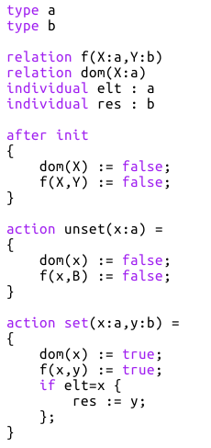
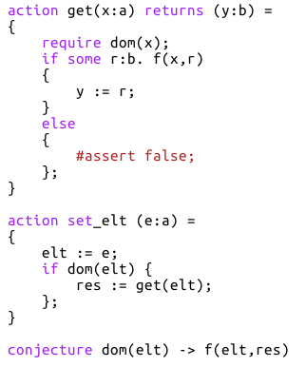
Example 2
We have a partial function a -> b represented by a relation f(X:a,Y:b)
The domain of the function is represented by the relation dom(X:a)
There is a variable elt in a and res in b.
We want to guarantee this property:
In order to have an inductive set of invariants, we need to add the following:
Note that this conjecture is not only universal, and so we will see that the naive generalization will generate an incorrect invariant.

Slide 14
Example 2
Counterexample found:
(inequalities over concrete values are not shown)
Initial environment:
elt=0
res=0
~dom(0)
dom(1)
~f(0,0)
~f(1,0)
After executing set_elt(1), dom(elt)=dom(1)=true, and
f(elt,res)=f(1,0)=false (the invariant is broken)
Type a
Type b
0
= elt
~dom
~f
0
= res
1
dom
~f
Notes:
TODO: show the counterexample and explain which constraint is model-dependent and why

Slide 15
Example 2
(inequalities over values/variables are not shown)
elt=0
res=0
~dom(0)
dom(1)
~f(0,0)
~f(1,0)
elt=A
res=C
~dom(A) dom(B) ~f(A,C)
~f(B,C)
B~=elt
~dom(elt) dom(B) ~f(elt,res)
~f(B,res)
Finally, we obtain the following formula:
This formula is too strong: some valid structures do not satisfy it.
Indeed, this formula is correct only if b has only one element (here, the value of res): we will say that this proposition of invariant is model-dependent.
If there was an other value D in b, the constraint ~f(B,D) would need to be added!
Notes:
TODO: show the counterexample and explain which constraint is model-dependent and why

Slide 16
Generalization with code analysis
Instead of keeping every constraint that characterizes the counterexample, we will analyze the code to determine:
Which constraints are needed in order to reproduce the counterexample, and which constraints are unnecessary. It will permit to generate shorter and more general invariants.
If the set of constraints obtained is independent of the model or if it is model-dependent, and in this case which constraints depend on the model. It will permit to know whether we need an invariant of the form ∀∃ or not, and, with some additional analyses, to generate such invariant.

Slide 17
Example 1
Let’s see how it would work with the first example.
Counterexample:
Initial environment:
elt1=2
elt2=1
f(0)=1 f(1)=1 f(2)=0
After executing change_elt1(0), f(elt1)=f(0)=1=f(1)=f(elt2) (the invariant is broken)
Type a
Type b
0
f
0:a~=1:a
0:a~=2:a
1:a~=2:a
0:b~=1:b
f
1
= elt2
1
2
= elt1
f
0

Slide 18
Example 1
We analyse the conjecture after the execution of change_elt1(0) and we try to highlight a set of constraints sufficient to break it (with as few constraints as possible).
Environment after the execution:
elt1=0
elt2=1
f(0)=1 f(1)=1 f(2)=0
Then we roll back through the execution of change_elt1(0) and we update this set of constraints.
0:a~=1:a
0:a~=2:a
1:a~=2:a
0:b~=1:b

Slide 19
Example 1
elt1=0
elt2=1
f(0)=1 f(1)=1 f(2)=0
elt=0
elt1=2
elt2=1
f(0)=1 f(1)=1 f(2)=0
elt=0
0:a~=1:a
0:a~=2:a
1:a~=2:a
0:b~=1:b
0:a~=1:a
0:a~=2:a
1:a~=2:a
0:b~=1:b
Argument of the action
elt1=2
elt2=1
f(0)=1 f(1)=1 f(2)=0
elt=0
elt1=2
elt2=1
f(0)=1 f(1)=1 f(2)=0
elt=0
0:a~=1:a
0:a~=2:a
1:a~=2:a
0:b~=1:b
0:a~=1:a
0:a~=2:a
1:a~=2:a
0:b~=1:b

Slide 20

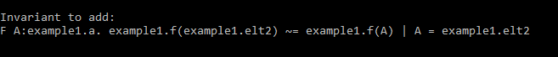
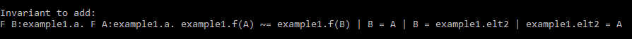
Example 1
elt1=2
elt2=1
f(0)=1 f(1)=1 f(2)=0
Finally, we have:
0:a~=1:a
0:a~=2:a
1:a~=2:a
0:b~=1:b
By generalizing these constraints like for the naive method, we obtain the following invariant:

Slide 21
Example 1
By continuing this process, we reach a fixpoint:
This is much simpler that the one obtained with the naive generalization:
But still more complicated than the expected invariant:

Slide 22
Example 2

Slide 23
Guarantees
Correctness: any invariant generated is correct, in the sense that it will always be satisfied in any execution (assuming that the initial set of invariants is also correct).
Completeness: If some valid universal invariant exist, one will always be proposed. If a ∀∃ formula is needed, one may be proposed (still need to be characterized). Guarantees on the generality of the invariant generated still need to be characterized.

